Slide 1



AI AGENT-BASED SUDOKU SOLVER
CSE440

Slide 2

Group -2
TEAM
Md. Shakibur Rahman
ID : 2013534042
Rifa Nanziba keka
ID : 2021936642
Sabiqun Nahar Ritu
ID : 2021597642

Slide 3

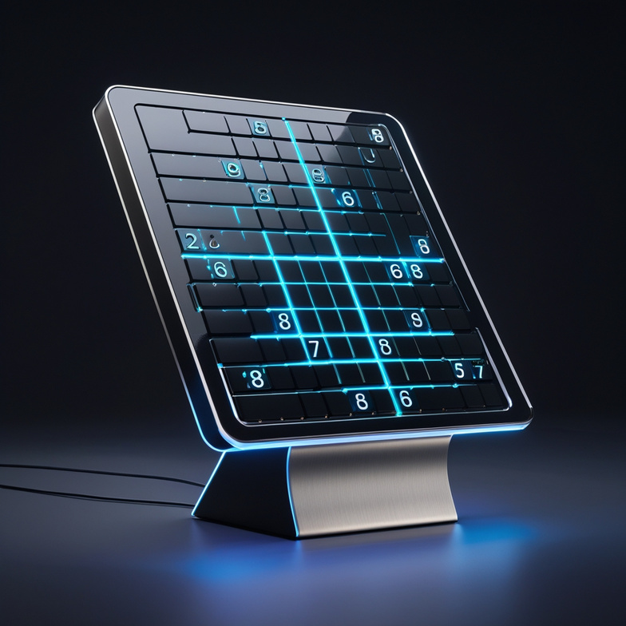
INTRODUCTION & OBJECTIVE
Sudoku is a logic puzzle requiring constraint-based reasoning. The goal is to develop an AI agent using constraint satisfaction techniques to solve puzzles efficiently and provide an interactive GUI for user input.
Objective:
Solve Sudoku using AI (CSP + Backtracking)
Use forward checking and heuristics
Create a user-friendly GUI with Tkinter

Slide 4


SUDOKU AS A CSP PROBLEM
Sudoku is framed as a Constraint Satisfaction Problem (CSP) where each of the 81 cells is a variable with a domain of digits 1 to 9. The constraints ensure no duplicate values appear in any row, column, or 3×3 subgrid. The solution satisfies all constraints without violating any Sudoku rule.
Variables: Each of the 81 cells.
Domains: Digits 1 to 9 (or fixed value if pre-filled).
Constraints:
Each digit appears once in every row, column, and 3x3 box.

Slide 5

AI TECHNIQUES USED
Backtracking Search: A depth-first search technique that recursively tries values and backtracks if invalid.
Forward Checking: An inference technique that eliminates future values that would violate constraints.
MRV Heuristic: A variable selection heuristic that Chooses the variable (cell) with the fewest legal values next.
These techniques reduce search space and solve faster.

Slide 6
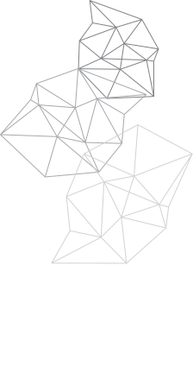
ALGORITHMS OVERVIEW
Forward Checking
Backtracking Search
Forward Checking
In Sudoku:
After assigning a value to a cell, it removes that value from the domains of all related empty cells (same row, column, and box)
If any domain becomes empty → early backtrack
In Sudoku:
Picks an empty cell
Tries values 1–9
If invalid later → goes back and tries the next option
Continues until the board is filled correctly or no solution exists
In Sudoku:
Among all empty cells, the one with the smallest domain (least options) is selected
This speeds up solving by reducing bad guesses early

Slide 7

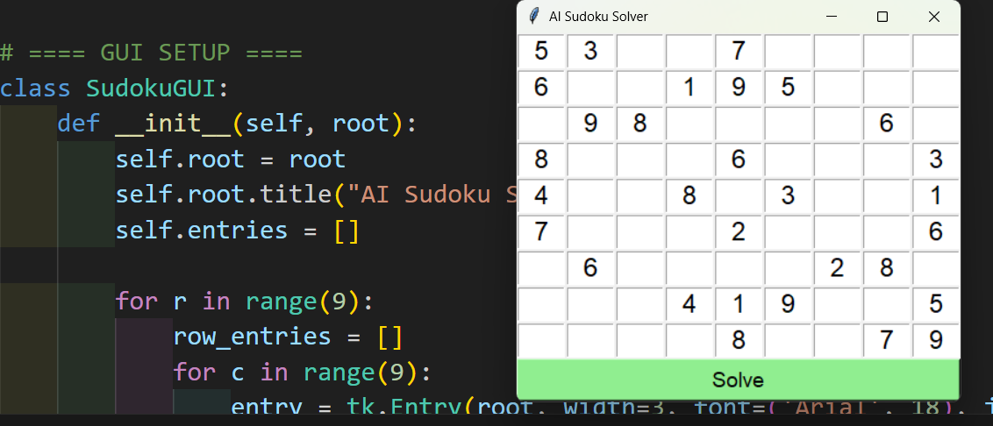
GUI DESIGN
GUI is made with Tkinter.
A 9x9 grid of text boxes for input.
A “Solve” button triggers the AI agent.
Displays the result in the same interface.
Clean, minimal design.

Slide 8
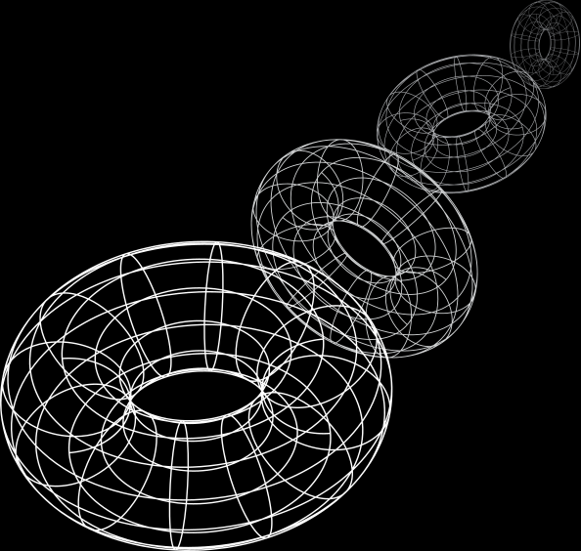
CONCLUSION & FUTURE WORK
Successfully applied CSP to solve Sudoku with AI.
Implemented inference and heuristic methods.
Simple and effective GUI integration.
Future Improvements:
Highlight solved cells
Add puzzle generator
Solve larger boards (16x16)
Use AC-3 or genetic algorithm

Slide 9
THANK YOU

